Slide 1
GRAFICI CREATI + codice

Slide 2
COUNTRY
POPULATION

Slide 3
SCALETTA
Spain table of population slide 4
Spain average rate of variation population 2013-22 slide 5
Indexing with mobile base of change of population 2013-2022 slide 6
Population by age chart slide 8
Pasta values retail slide 10
Pasta volumes spain slide 12
Average Retail Price slide 14
Unemployment slide 16

Slide 4
SPAIN table of population
get_eurostat("tps00001", time_format = "num") |>
filter(geo=="ES" & time<=time_range[2] & time>=time_range[1]) |>
mutate(values_MIL=round(values/1000000,3)) |>
pivot_wider(c(-values,-indic_de,-geo),names_from ="time", values_from ="values_MIL")

Slide 5

SPAIN Average rate of variation population 2013 -2022
pop<-get_eurostat("tps00001",time_format="num")
((pop |> filter(geo=="ES" & time==2022) |> pull(values)/pop |> filter(geo=="ES" & time==2013) |> pull(values))^(1/9)-1)*100

Slide 6
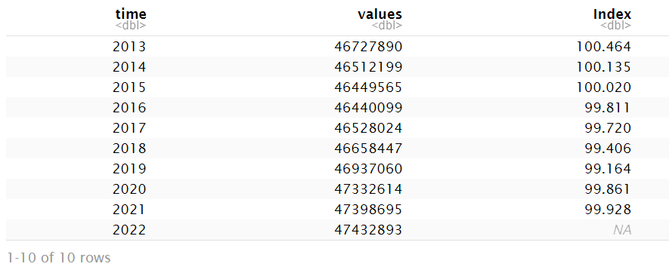
INDEXING with mobile base of change of population 2013-2022

Slide 7
pop1<-get_eurostat("tps00001",time_format="num")
pop1|>
filter(time>=2013 & time<=2022 & geo=="ES") |>
mutate(values_lead=lead(values)) |>
mutate(Index=round((values/values_lead)*100,3)) |>
select(time,values,Index)

Slide 8
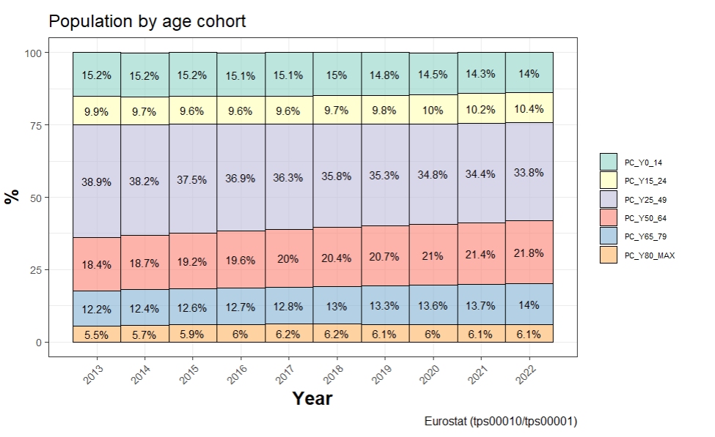
POPULATION BY AGE

Slide 9
get_eurostat("tps00010", time_format = "num") |>
filter(geo=="ES" & time<=time_range[2] & time>=time_range[1]) |>
ggplot(aes(x=time,y=values,fill=indic_de))+
geom_col(colour="black",alpha=.6,width=1)+
geom_text(aes(x=time, y=values, label=paste(values,"%",sep="")),position = position_stack(vjust = 0.5),size=3)+
scale_x_continuous(breaks=time_range[1]:time_range[2],minor_breaks=time_range[1]:time_range[2])+
theme_bw()+
scale_fill_brewer(palette = "Set3")+
labs(title="Population by age cohort",
x = "Year",
y = "%",
fill="",
caption="Eurostat (tps00010/tps00001)")+ # labels
theme(legend.position="right",
legend.text=element_text(size=6),
legend.key.size = unit(.5, "cm"),
axis.text=element_text(size=8),
axis.title=element_text(size=14,face="bold"),
axis.text.x = element_text(angle = 45, hjust = 1, size=8))

Slide 10
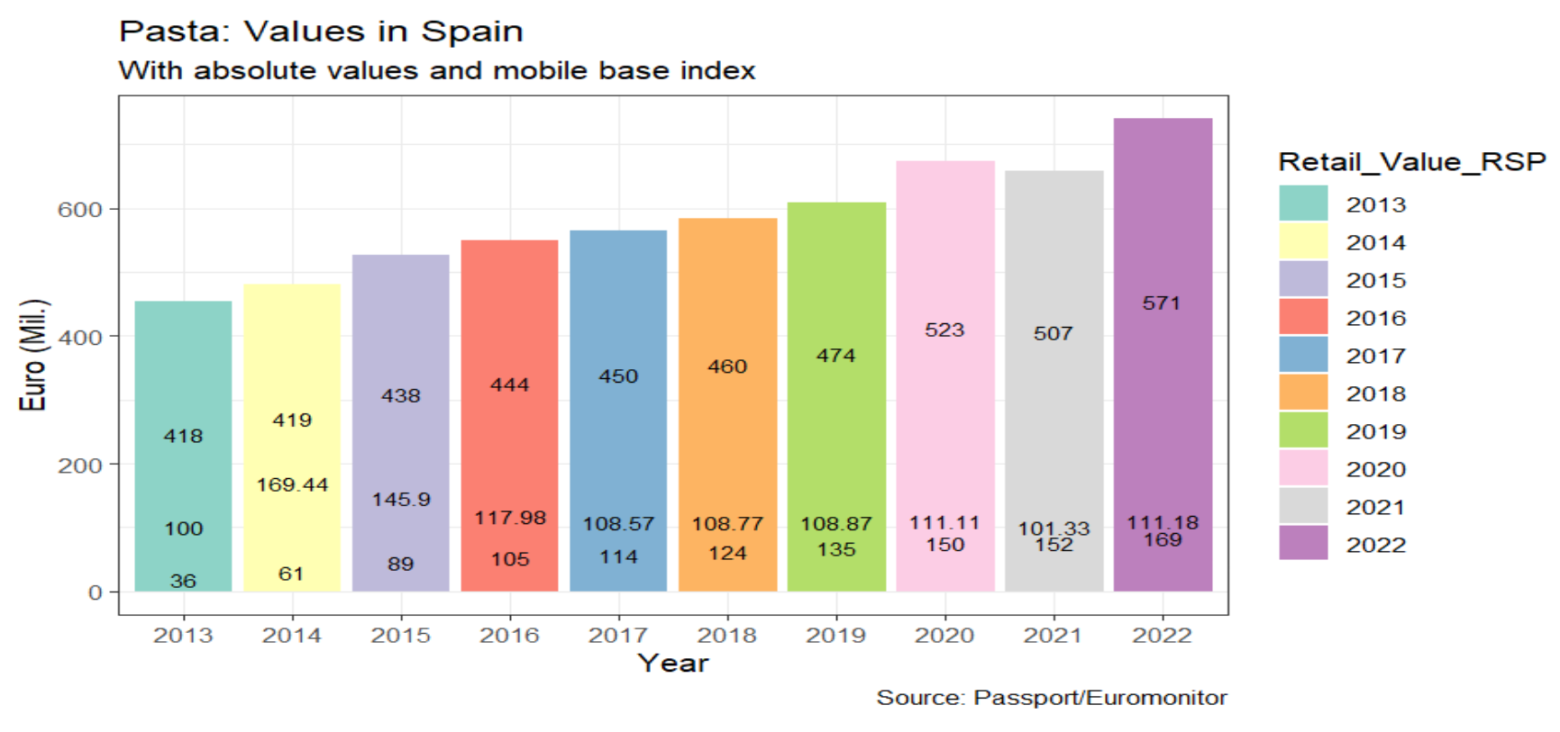
PASTA VALUES RETAIL

Slide 11
d_con_1 <- read_csv2("passport_retailvalues_spain_real.csv")
colnames(d_con_1)[3] = "Data_type"
d_con_2 <- d_con_1 |> filter(!row_number() %in% c(1:2)) |> filter(Category!="Frozen Noodles" & Category!="Instant Noodles" & Category!="Plain Noodles" & Category!= "Instant Noodle Cups" & Category!= "Instant Noodle Pouches" & Category != "Chilled Noodles" & Category != "Chilled Pasta" & Category!= "Dried Pasta")
d_con_<- d_con_2|>filter(Data_type!="Total Volume")
d_con <- d_con_ |> pivot_longer(names_to="Years", values_to="Retail_Value_RSP", cols = 6:15) |> group_by(Category, Years) |> summarise(Retail_Value_RSP=sum(as.numeric(Retail_Value_RSP)))
index<- d_con |> mutate(values_lead=lead(Retail_Value_RSP)) |> mutate(Index=round(values_lead/Retail_Value_RSP*100,2))
t <- data.frame(Years=as.character(2014:2022), Index=index$Index[1:9])
t1 <- data.frame(Years=as.character(2013), Index=100)
d_con_index <- rbind(t1,t)
pasta_values <- d_con |> ggplot(aes_string(x='Years', y='Retail_Value_RSP', fill="Years")) + geom_col() + labs(title="Pasta: Values in Spain",subtitle="With absolute values and mobile base index",y = "Euro (Mil.)",x= "Year",fill="Retail_Value_RSP",caption="Source: Passport/Euromonitor")+ # labels theme(legend.position="right",axis.text=element_text(size=8),
axis.title=element_text(size=14,face="bold"), axis.text.x = element_text(angle = 45, hjust = 1,size=8)) + geom_text(aes(x=Years, y=Retail_Value_RSP, label=Retail_Value_RSP), position = position_stack(vjust = 0.5), size=3)+ theme_bw() + geom_text(data=d_con_index, aes(x=Years, y=Index, label=Index), size=3) + scale_fill_brewer(palette="Set3")
pasta_values

Slide 12
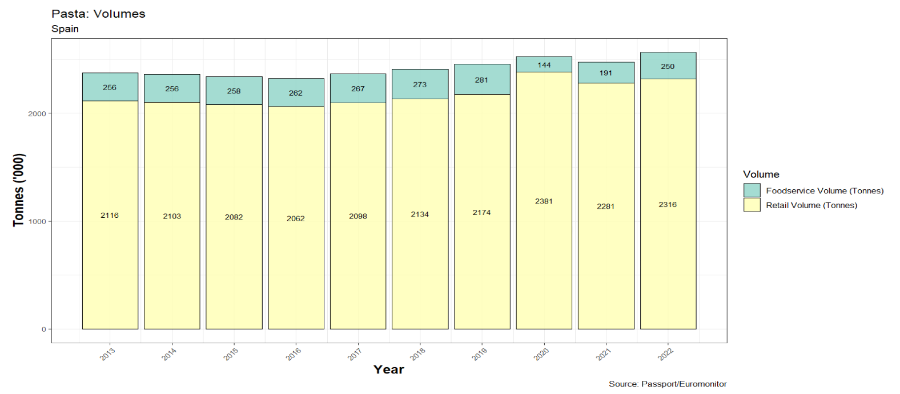
PASTA VOLUMES Spain

Slide 13
d_vol_g <- read_delim("Passport_Stats_vol.csv") |> filter(!row_number() %in% c(5:10)) |> select(-c(15:21))
d_vol_g2 <- d_vol_g |> pivot_longer(names_to = "Year", values_to="Volume", 5:14)
colnames(d_vol_g2)[3]="Data_Type"
d_vol_g2_tot <- d_vol_g2 |> group_by(Data_Type, Year) |> summarise(Total=sum(Volume))
d_vol_g2_tot |> ggplot(aes(x=as.integer(Year), y=as.integer(Total), label=round(Total,1), fill=Data_Type)) + geom_col(aes(colour=Data_Type), colour="black", alpha=.8)+ scale_fill_brewer(palette="Set3")+ geom_text(aes(x=as.integer(Year), y=Total, label=Total), position = position_stack(vjust = 0.5), size=3)+ theme_bw() +
labs(title = "Pasta: Volumes", subtitle = "Spain", y="Tonnes ('000)", x= "Year", fill="Volume", caption = "Source: Passport/Euromonitor")+ theme(legend.position="right", axis.text = element_text(size=8), axis.title = element_text(size = 14, face="bold"), axis.text.x = element_text(angle=45, hjust=1,size=8))+ scale_x_continuous(breaks = seq (2013,2022,by=1))

Slide 14
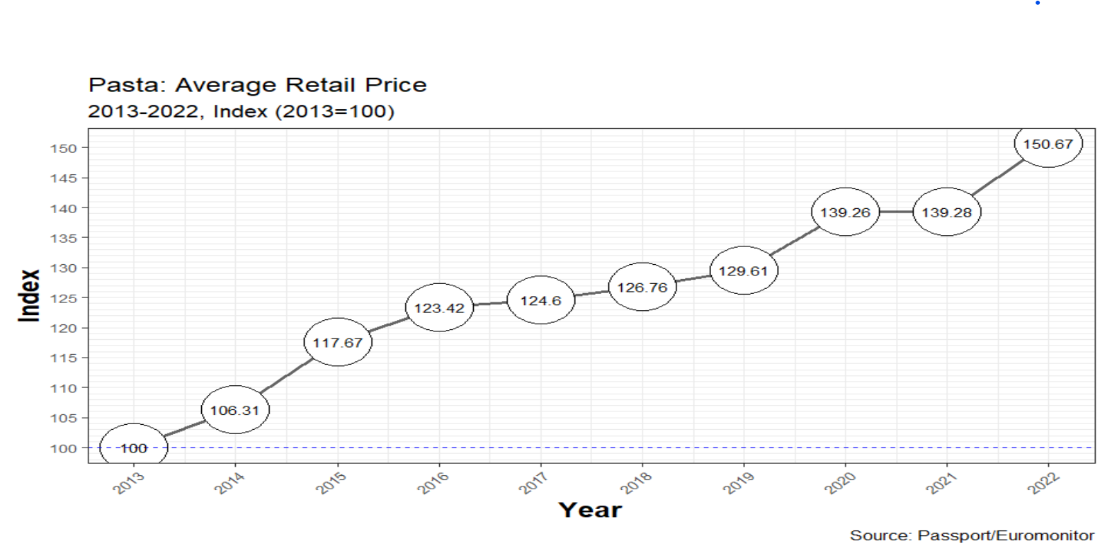
AVERAGE RETAIL PRICE indexed base

Slide 15
d_vol <- d_vol_g2_tot |> group_by(Years) |> summarise(Total=sum(Total))
d_con_years <- d_con |> group_by(Years) |> summarise(Retail_Value_RSP=sum(Retail_Value_RSP))
d_price <- full_join(d_vol, d_con_years) |> mutate(avg_price = ((Retail_Value_RSP*1000)/(Total*100)))
dd_p <- d_price |> mutate(Index=round((avg_price/avg_price[Years==2013])*100,2))
dd_p |> ggplot(aes(x=as.numeric(Years), y=Index), label=round(Fixed,1))+geom_line(alpha=.6, size=1)+
geom_point(alpha=1,pch=21,size=15,fill="white")+
geom_hline(yintercept=100,color="blue",linetype=2)+ scale_x_discrete(labels=as.character(dd_p$Years),breaks=dd_p$Years)+scale_y_continuous(breaks=seq(80,160,5),minor_breaks=seq(80,160,1))+ theme_bw()+
labs(title="Pasta: Average Retail Price",
subtitle=paste(time_range[1],"-",time_range[2],", Index (", time_range[1],"=100)",sep=""),
y = "Index",
x= "Year",
color="Country",
caption="Source: Passport/Euromonitor")+ # labels
theme(legend.position="right",
axis.text=element_text(size=8),
axis.title=element_text(size=14,face="bold"),
axis.text.x = element_text(angle = 45, hjust = 1,size=8))+geom_text(label=dd_p$Index, size=3)+scale_x_continuous(breaks = seq (2013,2022,by=1))

Slide 16
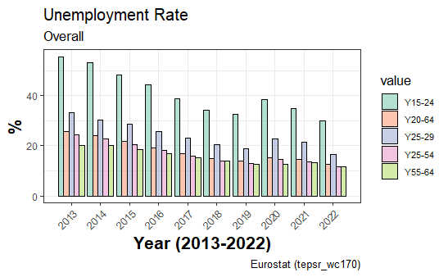
UNEMPLOYMENT

Slide 17
time_range <- c(2013,2022)
Unemployment <- get_eurostat("tepsr_wc170", time_format = "num")|>
filter(geo=="ES" & time>=time_range[1] & time<=time_range[2]& age!="Y15-74")
ggplot(data= Unemployment, aes(x=time, y=values, fill=age))+
geom_col(colour="black", alpha=.5, position = position_dodge(.9))+
scale_x_continuous(breaks = time_range[1]:time_range[2], minor_breaks = time_range[1]:time_range[2])+
theme_bw()+
scale_fill_brewer(palette="Set2")+
labs(title="Unemployment Rate", subtitle = "Overall", y= "%", x="Year (2013-2022)", fill="value", caption="Eurostat (tepsr_wc170)")+ theme(legend.position = "right", axis.text = element_text(size=8),legend.text=element_text(size=7), legend.key.size = unit(.5, "cm"),axis.title = element_text(size=14, face="bold"),axis.text.x = element_text(angle=45, hjust = 1, size=8))

Slide 18
DEMAND

Slide 19
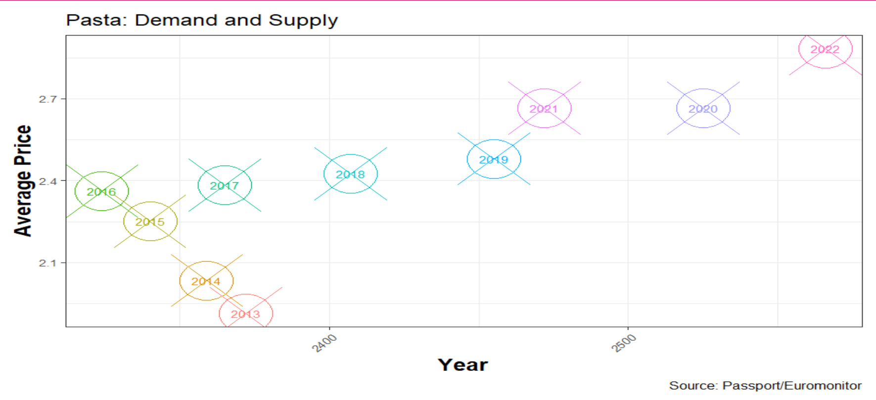
SUPPLY AND DEMAND

Slide 20
dd_p |> ggplot(aes(x=Total_Volume, y=avg_price, colour=Years)) + geom_point(alpha=1,pch=21,size=15,fill="white") + theme_bw() + geom_text(label=dd_p$Years,size=3) + geom_point(shape=4, size=20) + scale_fill_brewer() +
theme( legend.position="none",
axis.text=element_text(size=8),
axis.title=element_text(size=14,face="bold"),
axis.text.x = element_text(angle = 45, hjust = 1,size=8))+ labs(title="Pasta: Demand and Supply", y = "Average Price",
x= "Year",
caption="Source: Passport/Euromonitor")

Slide 21
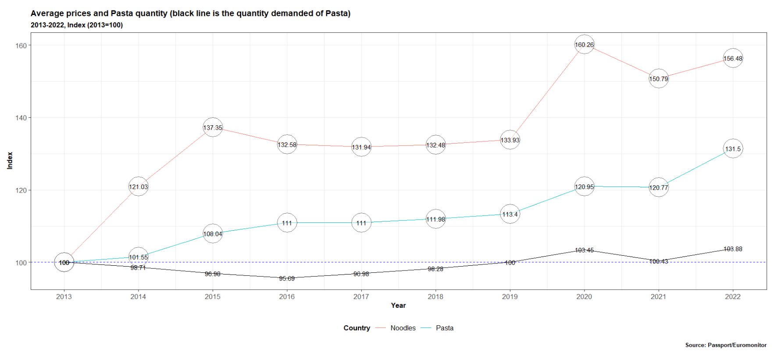
AVERAGE PRICE CHANGE AND TOTAL DEMAND CHANGE

Slide 22
d_pd_1 <- read_csv2("passport_retailvalues_spain_real.csv")
view(d_pd_1)
d_pd_1<-d_pd_1 |> filter(Category!="Chilled Noodles" & Category!="Frozen Noodles" & Category!="Plain Noodles" & Category!="Chilled Pasta" & Category!="Dried Pasta" & Category!="Instant Noodles" & Category!="Instant Noodle Cups" & Category !="Instant Noodle Pouches") |> filter(!row_number() %in% c(1:2))
colnames(d_pd_1)[3] = "Data_type"
d_pdv_2<- d_pd_1|>filter(Data_type!="Retail Value RSP")
d_pdv <- d_pdv_2 |> pivot_longer(names_to="Years", values_to="Total_Volume", cols = 6:15)|> select(-c(1,)) |> select(-c(2:4))
d_pdv$Total_Volume <- as.numeric(gsub('.','',d_pdv$Total_Volume, fixed=TRUE))

Slide 23
d_pdp_2<- d_pd_1|>filter(Data_type!="Total Volume")
d_pdp <- d_pdp_2 |> pivot_longer(names_to="Years", values_to="Retail_Value_RSP", cols = 6:15)|> select(-c(1,)) |> select(-c(2:4))
d_pdp$Retail_Value_RSP <- as.numeric(gsub('.','',d_pdp$Retail_Value_RSP, fixed=TRUE))
d_pricebycategory <- full_join(d_pdv, d_pdp) |> mutate(avg_price = Retail_Value_RSP/Total_Volume)
d_indexbycategory <- d_pricebycategory |> group_by(Category)|> mutate(Index=as.numeric(round((avg_price/avg_price[Years==2013])*100,2)))
d_volpasta <- d_pd_1 |> filter(Category=="Pasta") |> pivot_longer(names_to="Years", values_to="Total_Volume", cols = 6:15) |> filter(Data_type=="Total Volume") |> select(-c(1:5))|> mutate(Total_Volume=as.numeric(Total_Volume)) |> mutate(Index=as.numeric(round((Total_Volume/Total_Volume[Years==2013])*100,2)))

Slide 24
gg <- d_indexbycategory|> ggplot() + geom_line((aes(x=as.numeric(Years), y=Index, group=Category, color=Category))) + geom_point(aes(x=as.numeric(Years), y=Index),alpha=.5,pch=21,size=12,fill="white") + geom_text(data=d_indexbycategory, aes(x=as.numeric(Years), y=Index), label=d_indexbycategory$Index, size=3, colour="black")+
scale_x_continuous(breaks = seq (2013,2022,by=1)) + theme_bw() + geom_hline(yintercept=100,color="blue",linetype=2) + geom_line(data=d_volpasta, aes(x=as.numeric(Years), y=Index)) + geom_text(data=d_volpasta, aes(x=as.numeric(Years), y=Index), label=d_volpasta$Index, size=3, colour="black") + labs(title="Average prices and Pasta quantity (black line is the quantity demanded of Pasta)",
subtitle=paste(time_range[1],"-",time_range[2],", Index (", time_range[1],"=100)",sep=""),
y = "Index",
x= "Year",
color="Country",
caption="Source: Passport/Euromonitor", size=4) + theme(legend.position="bottom", title =element_text(size=9, face='bold')) # labels
gg

